Slide 1
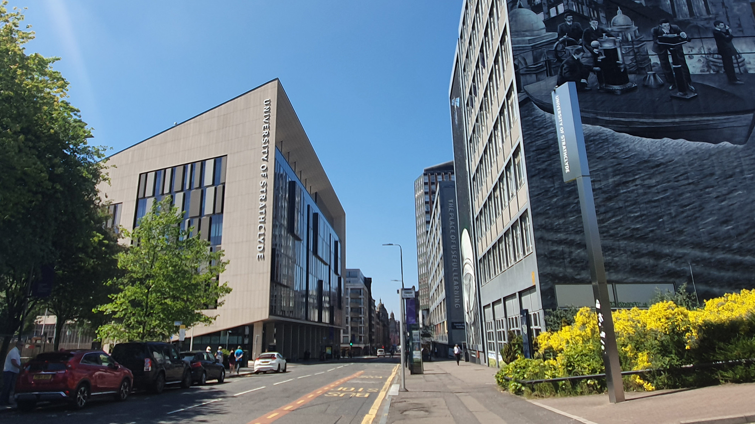

Digital filters
Digital Filters Design: IIR design methods
carmine.clemente@strath.ac.uk

Slide 2
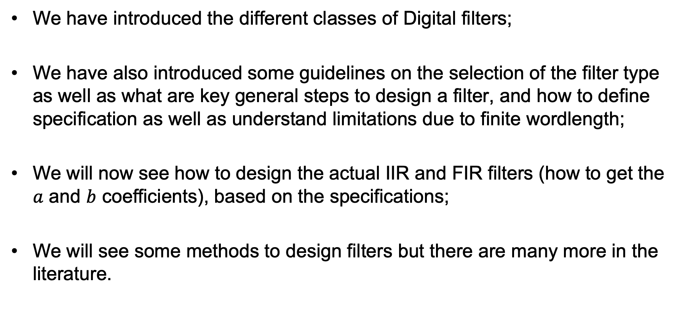
Introduction
We have introduced the different classes of Digital filters;
We have also introduced some guidelines on the selection of the filter type as well as what are key general steps to design a filter, and how to define specification as well as understand limitations due to finite wordlength;
We will now see how to design the actual IIR and FIR filters (how to get the $a$ and $b$ coefficients), based on the specifications;
We will see some methods to design filters but there are many more in the literature.

Slide 3
IIR Design Methods
Impulse Invariance Method
Converts an Analog filter in a digital filter
2. Bilinear Design Method
Applies bilinear transformation to an analog filter to derive the digital one

Slide 4
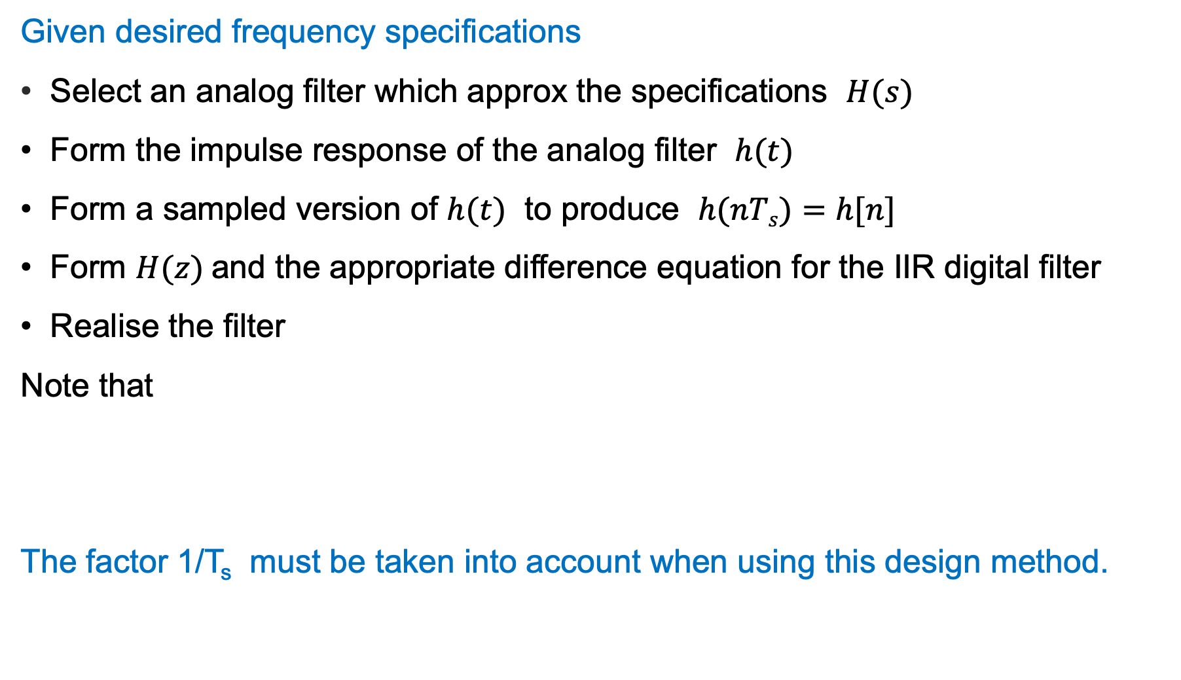
Impulse invariance method
Given desired frequency specifications
Select an analog filter which approx the specifications $H(s)$
Form the impulse response of the analog filter $h(t)$
Form a sampled version of $h(t)$ to produce $h(nTs)=h[n]$
Form $H(z)$and the appropriate difference equation for the IIR digital filter
Realise the filter
Note that
The factor 1/T_{s} must be taken into account when using this design method.

Slide 5
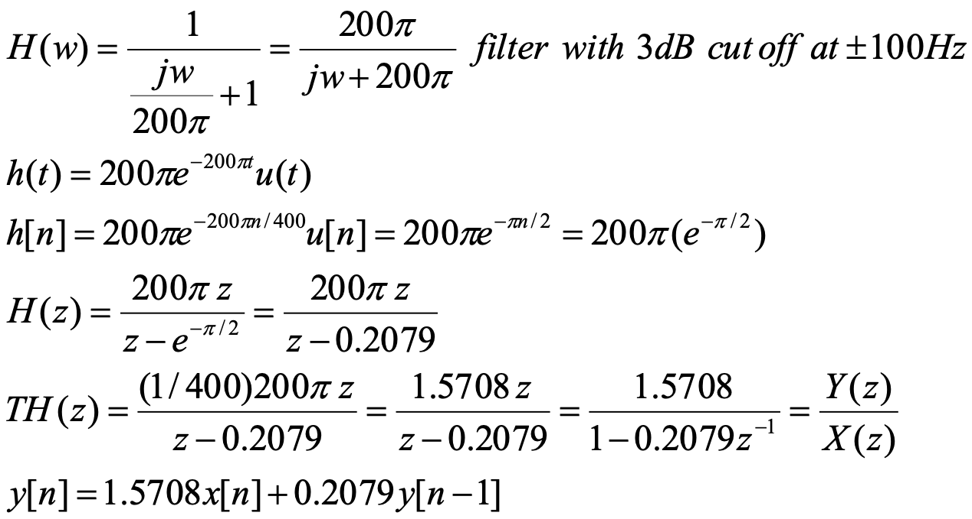
Impulse invariance method
Example:
We want to design an IIR digital filter with the following response starting from an analog version, using the Impulse invariance method and a sampling frequency of 400 Hz.
-200π 200π $ω$
-100 100 f

Slide 6
Impulse invariance method
-200π 200π $ω$

Slide 7
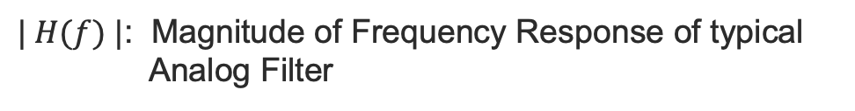
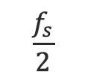
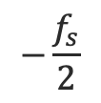
Impulse invariance method - Observations
$| H(f) |$: Magnitude of Frequency Response of typical Analog Filter
We get aliasing
f
$$−\frac{f_{s}}{2}$$
$$\frac{f_{s}}{2}$$
What happens to the components outside the interval $[−f_{s}/2 ,f_{s}/2]$?

Slide 8
Impulse invariance method - Observations
Main disadvantage is that aliasing occurs in the sampling process;
It occurs as an analog filter cannot be necessarily bandlimited;
The degree of aliasing depends on the characteristics of the analog filter with respect to the sampling frequency;
Despite its simplicity, the aliasing issue makes this method unpractical for high pass filters, while for other types of filters overdesign of the analog filter is required in order to meet specifications.

Slide 9


Bilinear Transformation Method for IIR
The bilinear transformation method applies the following transformation to the continuous system function $H(s)$ of an analog filter:
From $H(s)$ to $H\left(z\right)$from $H(z)$ to $H(s)$

Slide 10
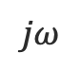
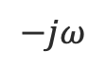
Bilinear Transformation Method for IIR
Let’s see how the transformation operates
s-plane
$$jω$$
z-plane
$$−jω$$

Slide 11
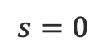
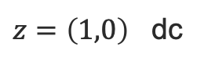
Bilinear Transformation Method for IIR
Let’s see how the transformation operates
s-plane
So dc in continuous domain maps in dc in discrete domain!
$$jω$$
z-plane
$$s=0$$
$z=\left(1,0\right)$ dc
$$−jω$$

Slide 12


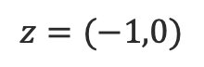
Bilinear Transformation Method for IIR
Let’s see how the transformation operates
s-plane
$$jω$$
$$ω,s→∞ ⟹ z=−1$$
z-plane
$$z=(−1,0)$$
$$ω,s→−∞ ⟹ z=−1$$
$$−jω$$

Slide 13
Bilinear Transformation Method for IIR
Let’s see how the transformation operates
s-plane
$$jω$$
Unstable Region
Stable Region
Unstable Region
z-plane
$$z=(−1,0)$$
$$−jω$$

Slide 14
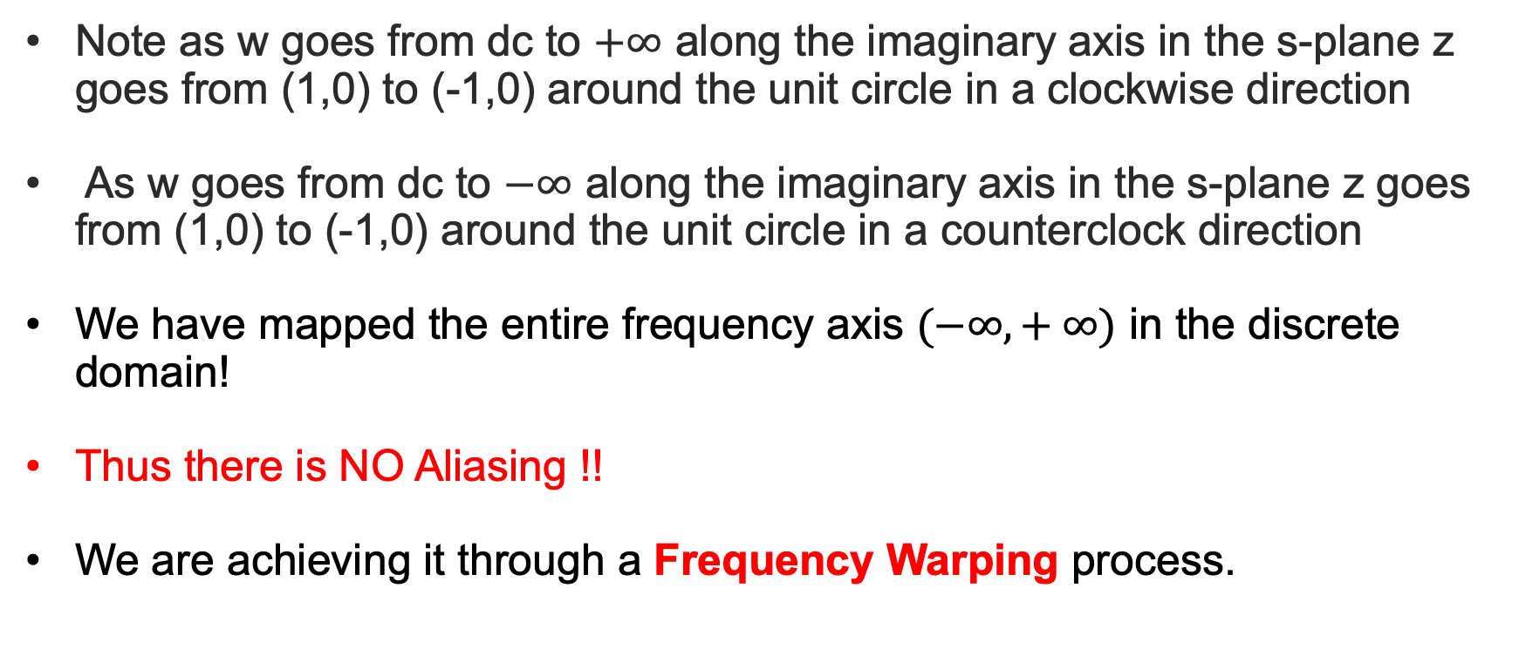
Bilinear Transformation Method for IIR
Note as w goes from dc to $+∞$ along the imaginary axis in the s-plane z goes from (1,0) to (-1,0) around the unit circle in a clockwise direction
As w goes from dc to $−∞$ along the imaginary axis in the s-plane z goes from (1,0) to (-1,0) around the unit circle in a counterclock direction
We have mapped the entire frequency axis $(−∞,+ ∞)$ in the discrete domain!
Thus there is NO Aliasing !!
We are achieving it through a Frequency Warping process.

Slide 15
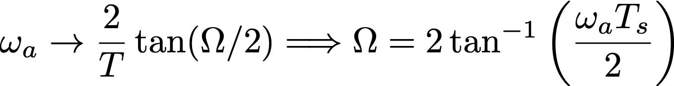
Frequency Warping in BLT
s
s
s
s
s

Slide 16
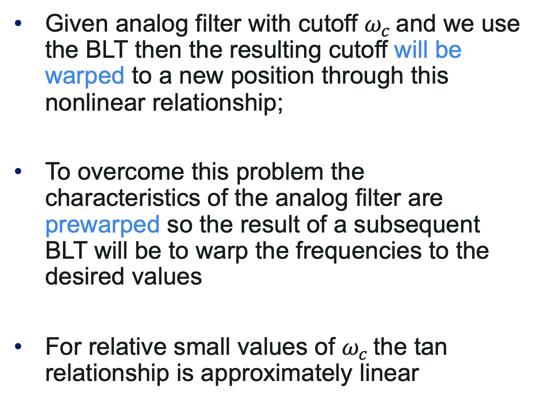
BLT - Observations
Given analog filter with cutoff $ω_{c}$ and we use the BLT then the resulting cutoff will be warped to a new position through this nonlinear relationship;
To overcome this problem the characteristics of the analog filter are prewarped so the result of a subsequent BLT will be to warp the frequencies to the desired values
For relative small values of $ω_{c}$ the tan relationship is approximately linear

Slide 17
BLT – Design Method
1) Prewarp the characteristics of the filter
2) Select Analog Filter
3) Apply BLT

Slide 18
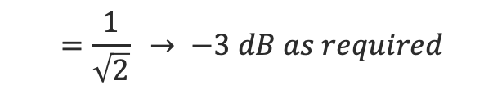
BLT – Design Method
Example
Design a digital LPF with cutoff $Ω_{c}$=±π/3 and T=2 secs
0.366(1.05 –j0.886)
$$=\frac{1}{\sqrt{2}} → −3 dB as required$$

